Slide 1
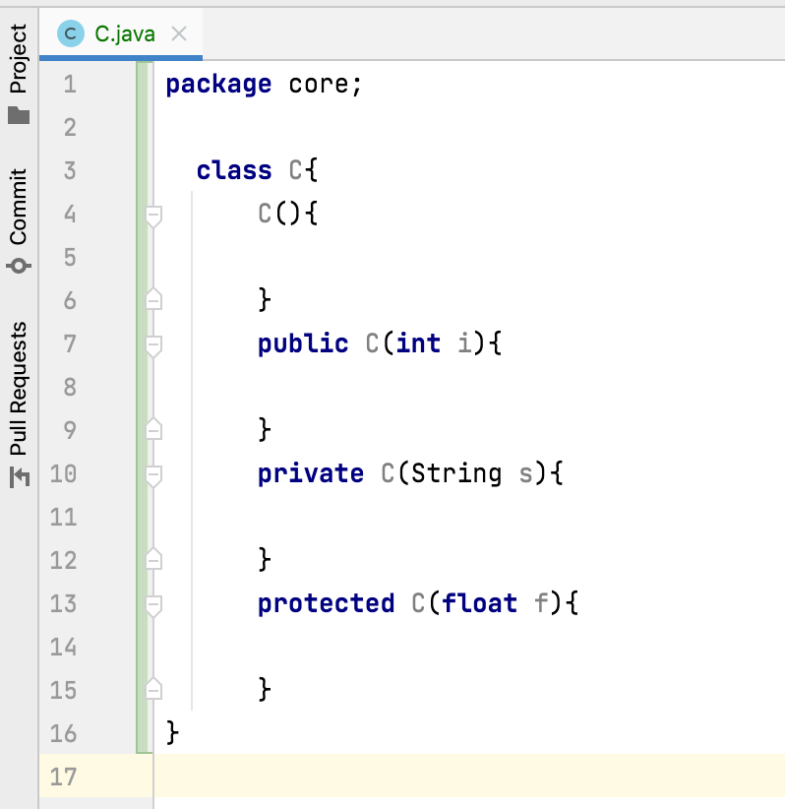
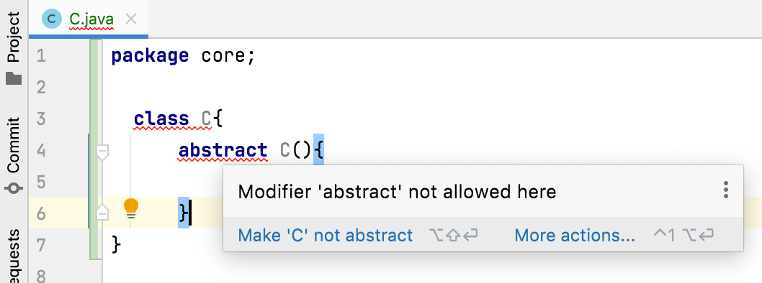
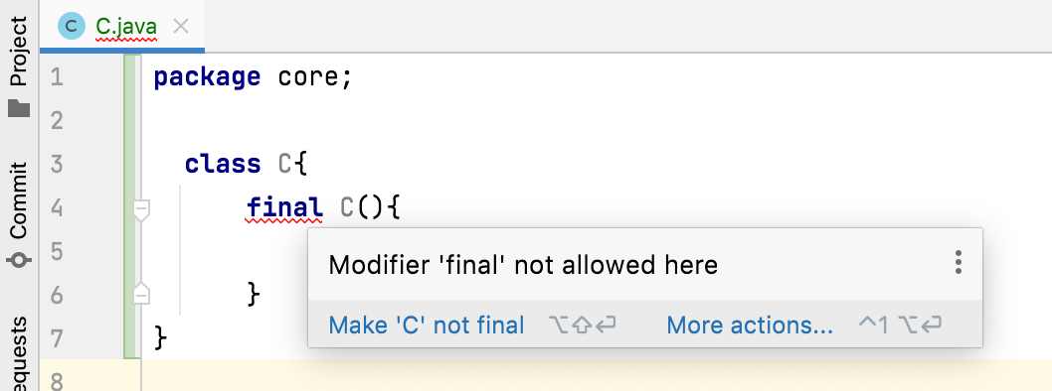
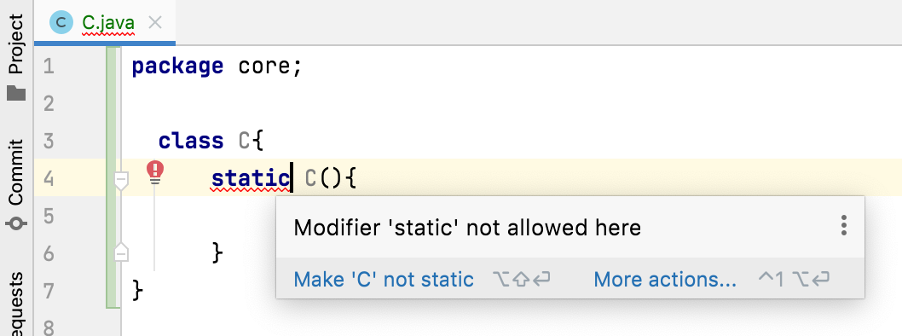
Which modifiers are allowed for constructors in java?
Modifiers public, protected, default and private are allowed with constructors.
Cannot be abstract, final, native, static, or synchronized

